Slide 1

CODE3102U
CODE3102U
Why Service Mesh?
Anderson Duboc
Senior Systems Engineer
Office of the CTO, Ambassador
@duboc
#vmworld #code3102u

Slide 2


Developers have a powerful voice
Photo by Adam King on Unsplash

Slide 3

And they want speed

Slide 4
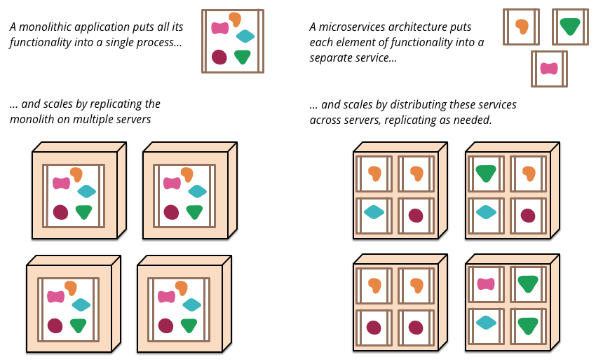
Monolith vs Microservices
~ https://martinfowler.com/articles/microservices.html

Slide 5
Monolith
Application
/search
DB
/delivery
/payment
/inventory
VM

Slide 6

Let’s break my monolith
Photo by Dawn Armfield on Unsplash

Slide 7
Microservices
/payment
/web
/search
/payment
/inventory
/inventory
/search

Slide 8
Microservices may own data
/payment
/web
/inventory
/search

Slide 9
Multiple ways to interact now
/payment
/web
/inventory
/search

Slide 10
Network of services
Service
Service
Service
Service
Service
Service
Service
Service
Service
Service
Service
Service
Service
Service
Service
Service
Service
Service
Service
Service
Service
Service
Service
Service
Service
Service
Service
Service
Service
Service
Service
Service

Slide 11
Microservices == Distributed Computing
OS
OS
JVM
JVM
Service A
Service A

Slide 12

Fallacies of Distributed Computing
The network is reliable
Latency is zero
Bandwidth is infinite
Topology does not change
There is one administrator
Transport cost is zero
The network is homogeneous
Photo by Nasa on Unsplash

Slide 13
Cascading effect?

Slide 14
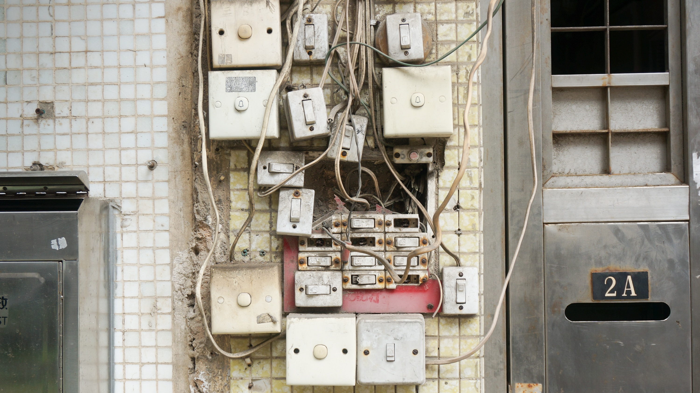
Microservices
Photo by Yung Chang on Unsplash

Slide 15

Embedding capabilities, example:
Container
Container
JVM
JVM
Service A
Service B
Discovery
Discovery
Resiliency
Resiliency
Load-balancer
Load-balancer
Metrics
Metrics
Tracing
Tracing
Java only, tons of libraries

Slide 16

Companies want developers to focus on business logic
Photo by Headway on Unsplash

Slide 17

Let’s go back to earth
Photo by Nasa on Unsplash
Photo by NASA on Unsplash

Slide 18
We are moving the complexity of this new service architecture to the space between our services

Slide 19









API
Authentication
Discovery
Tracing
Invocation
Service
Monitoring
Elasticity
Logging
Resilience
Pipeline

Slide 20

Introducing Service Mesh
Connect
Control
Secure
Observe

Slide 21

Service Mesh Landscape

Slide 22

Sidecar Proxy Architecture

Slide 23
Sidecar Proxy Architecture
Service A
Service B
App A
App B
Observability
Proxy
Proxy
Traffic Management
Security
Service Mesh Control Plane

Slide 24


Telemetry
Service A
Service B
App A
App B
Proxy
Proxy
Stats Adapter

Slide 25



Mutual TLS
Service A
Service B
App A
App B
Proxy
Proxy
Certificate Manager

Slide 26


Distributed Tracing
Service A
Service B
Service C
App A
App B
App C
Proxy
Proxy
Proxy

Slide 27

Developers should offload stuff
Decouple App from Infra

Slide 28

Operators should work independent
Focus on more resilient environment

Slide 29
Without Service Mesh
Container
Container
JVM
JVM
Service A
Service B
Discovery
Discovery
Resiliency
Resiliency
Load-balancer
Load-balancer
Metrics
Metrics
Tracing
Tracing

Slide 30
With Service Mesh
Pod
Pod
Container
Container
JVM
JVM
Service A
Sidecar intercepts all network traffic
Service B
Sidecar Container
Sidecar Container

Slide 31






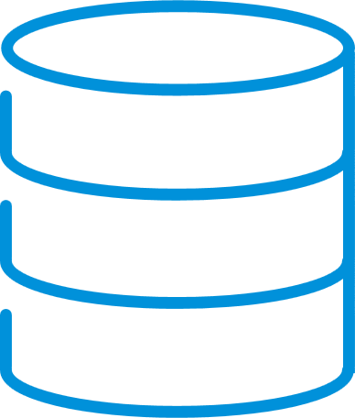





VMware’s Enterprise-Class
Service Mesh Vision
Discovery
Visibility
Control
Security
Users
Services
Data
Kubernetes
Public Clouds
VMs
SaaS
Serverless

Slide 32







Mesh expansion across any Infrastructure
Users
Services
Data
Tanzu Service Mesh
Global Observer & Controller
Containers
Public Clouds
VMs & Bare Metal
Serverless
SaaS
Sidecars
Sidecars / Federation
Integrations
Integrations and new capabilities
Notes:
See appendix for detailed service mesh expansion slides.
The main message of slide 20 is the following:
As mentioned, VMware has built the global orchestrator into Tanzu Service Mesh to connect and secure services on any infrastructure. Using sidecars, we can support any Kubernetes clusters on any cloud. Using the combination of sidecars and federation, services deployed on any public cloud can communicate with each other. Using the integration with the AVI load balancers, service mesh can enable services deployed on VMs to communication with other services.

Slide 33




Tanzu Service Mesh Use Cases
Across Users, Services, and Data
Agility
Business Continuity
Security
Visibility
Hybrid and Multi-Cloud Application Patterns
High Availability
and Failover
E2E Encryption for Compliance
Visibility for DevOps, SREs, and SecOps
v1
v2
App Mobility and Migration
App SLO Policies & Intelligent Autoscaling
Context-based Security Policies w/ Auditing
Controlled Service Deployments and Upgrades

Slide 34

Demo

